Slide 1
3 Tier Architecture and MVC
Prepared for Vth semester DDU-CE students 2018-19 WDDN
Apurva A Mehta

Slide 2
Introduction
In software engineering, multitier architecture is a client–server architecture in which presentation, application processing, and data management functions are physically separated.
The most widespread use of multitier architecture is the three-tier architecture.

Slide 3
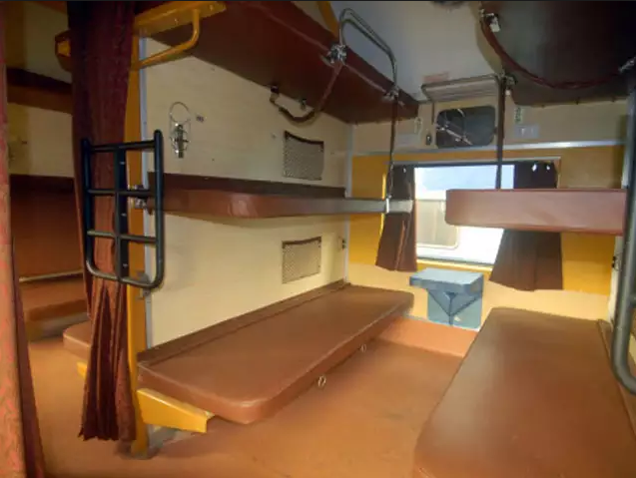
Tier(Layer)

Slide 4
Tier(Layer)
A layer is a reusable portion of code that performs a specific function.
In the .NET environment, a layer is usually set up as a project that represents this specific function.
This specific layer is in charge of working with other layers to perform some specific goal.

Slide 5
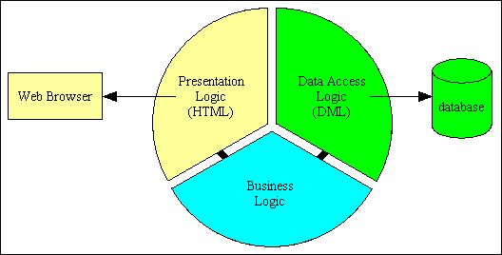
3 Tier Architecture
User Interface Layer
Business Logic Layer
Data Layer
Notes:
In the 3-tier equivalent, communication between layers is bi-directional and always passes through the Middle tier
The idea of three-tier design is that the functionality of most complete applications can be divided into three main levels .
Presentation
Business
Data
The first level is the user interface (or presentation tier), which displays controls and receives and validates user input. All the event handlers in your web page are in this first level.
The second level is the business tier, where the application-specific logic takes place.
Application specific logic, calculations are part of this layer.
Interface between Data and UI.
Validation of Input Data.
A Data Layer contains methods that helps the Business Layer to connect the data and perform required actions, whether to return data or to manipulate data (insert, update, delete and so on).

Slide 6
Advantages of 3Tier Arch
Enables logical and physical separation between layers
Migration to new graphical environment is faster
Changes to any layer is faster
Parallel development is possible
Notes:
It makes the logical separation between business layer and presentation layer and database layer.
Migration to new graphical environments is faster.
As each tier is independent it is possible to enable parallel development of each tier by using different sets of developers.
New rules or new validation rules can be defined any time and changes made to middle layer will not effect presentation layer.

Slide 7
Disadvantages of 3Tier Arch
Time consuming
Need good expertise in object oriented concept
It is more complex to build.
Notes:
To implement even small part of application it will consume lots of time.

Slide 8
What is MVC?
Request
Controller
Step 1
Incoming request directed to Controller

Slide 9

What is MVC?
Controller
Model
Step 2
Controller processes request and forms a data Model

Slide 10

What is MVC?
Controller
View
Step 3
Model is passed to View

Slide 11
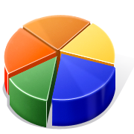
What is MVC?
Controller
View
Step 4
View transforms Model into appropriate output format

Slide 12
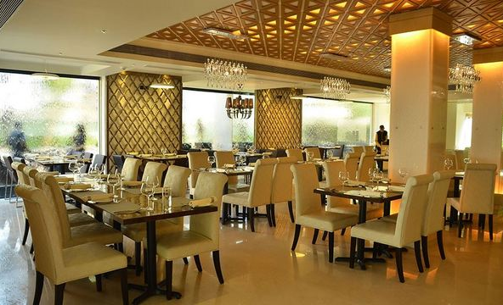
Still doubt?
Lets go to a restaurant

Slide 13
Model View Controller
View uses the model obtained from controller
Database
Model
User
Controller
View
Notes:
Model View Controller or MVC as it is popularly called, is a software design pattern for developing web applications. A Model View Controller pattern is made up of the following three parts −
Model − The lowest level of the pattern which is responsible for maintaining data.
View − This is responsible for displaying all or a portion of the data to the user.
Controller − Software Code that controls the interactions between the Model and View.
MVC is popular as it isolates the application logic from the user interface layer and supports separation of concerns. Here the Controller receives all requests for the application and then works with the Model to prepare any data needed by the View. The View then uses the data prepared by the Controller to generate a final presentable response. The MVC abstraction can be graphically represented as follows.
The Model
The model is responsible for managing the data of the application. It responds to the request from the view and it also responds to instructions from the controller to update itself.
The View
It means presentation of data in a particular format, triggered by a controller's decision to present the data. They are script-based templating systems like JSP, ASP, PHP and very easy to integrate with AJAX technology.
The Controller
The controller is responsible for responding to the user input and perform interactions on the data model objects. The controller receives the input, it validates the input and then performs the business operation that modifies the state of the data model.

Slide 14
3 Tier and MVC
At first glance, the three tiers may seem similar to the model-view-controller (MVC) concept; however, topologically they are different. A fundamental rule in a three tier architecture is the client tier never communicates directly with the data tier; in a three-tier model all communication must pass through the middle tier. Conceptually the three-tier architecture is linear. However, the [model-view-controller] MVC architecture is triangular: the view sends updates to the controller, the controller updates the model, and the view gets updated directly from the model.
Notes:
http://en.wikipedia.org/wiki/Multitier_architecture#Three-tier_architecture

